Slide 1
TCS Store Command Centre
Empowering stores with TCS Internet of Things platform - TCUP

Slide 2

A Day in the Life of Store Associate
I don’t know my customers?
What is going on in my store?
On every business day, I have to manage…
Who are my most valuable customers?
What does my customer want?
Where are customers spending more time?
How is the footfall?
Is there a large queue at the register?
Is there an associate who is idle?
Are the demo stations, displays and other media working fine?
How is the energy utilization?
Store Open / Close
In-store Displays
Planograms & Displays
Compliance and audits
I cannot plan my activities
What time will the truck be at my store to deliver order?
How can I know the availability of products?
Which shelves are empty or going to be?
Why has an item become a hot seller?
What are the pending activities and which is the most important one?
How to manage store performance, customer satisfaction, cleanliness, safety and quality – all at the same time?
Inventory Operations
Reporting
Task execution and actions
I’m on the run all the time..
Customer Experience & Checkout
Loss Prevention
I have 15 different applications to run my store…
I spend 2 hours in generating my reports and analyzing them
I spend more time in getting things done
How do I review my sales and enable more sales at my store?

Slide 3
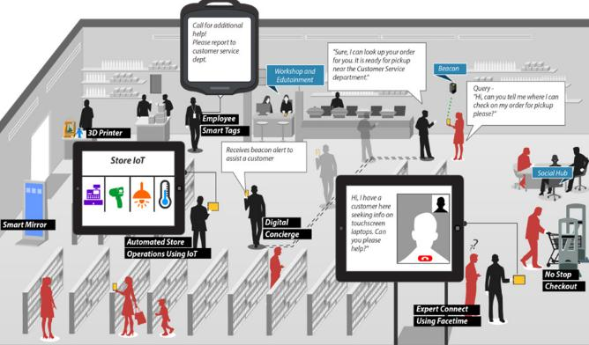

Why Internet of Things for Stores?
Employee, Energy and Maintenance costs attribute to major expenses for most stores…
200+ different device categories in the store – Fast evolving landscape
30,000+ service calls across stores for average large sized retailer
400+ Decisions by the Store Manager on any given day
TCUP in store can…
1
2
Increase
Associates productivity
Increase
Stock availability
Engage Customers
3
4
Automate
Content Management
5
Manage
Energy & Devices
Leading to…
Personalized experience for customers
More work done by associates
Optimized inventory
Reduced Energy consumption
Predictive maintenance of devices

Slide 4
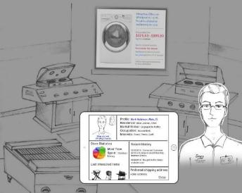
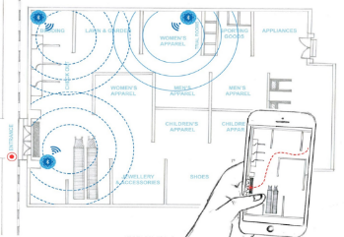

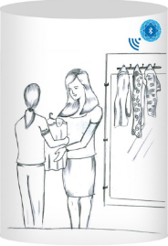
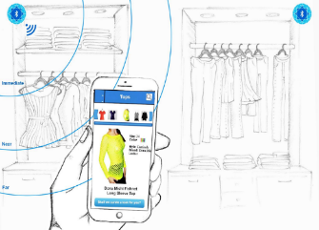
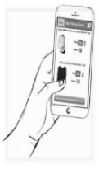
Personalized Customer experience – Making stores your front-end
Premium customers are handled with special attention
Associates gets notification to pack order, when a customer with BOPIS order reaches store
BLE Beacon
BLE Beacon
High valued customer
Merchandise Pickup
Customers get location specific promotions & coupons on Mobile
Customers use Connected dressing room app to request for alternate merchandise (color, size) from inside the dressing room
BLE Beacon
BLE Beacon
Location based promotions
Connected Dressing Room

Slide 5
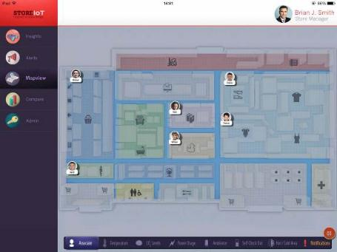
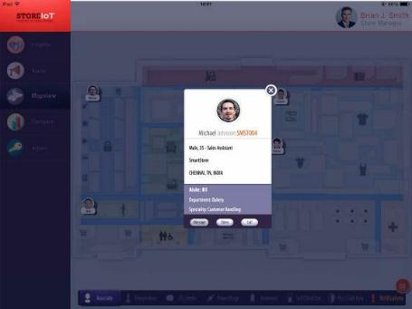
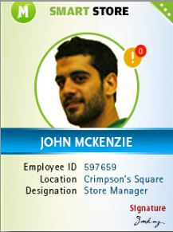
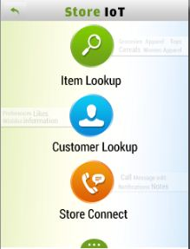
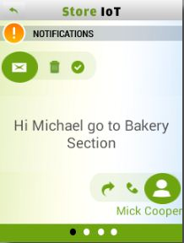
Empowering associates to increase productivity
BLE Beacon
BLE Beacon
Location based Task management
Expert Finder
Smart Associate ID
Associate location based task assignment
Interface to find experts for customer service
Android based smart ID
Prioritizing between alters and notifications
Helps leverage on existing expertise
Real-time task alerts
Real-time activity tracking
Customer, product look-up

Slide 6

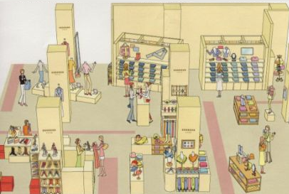
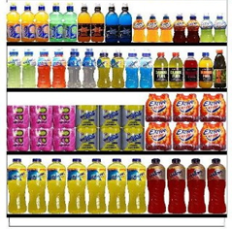
Inventory Management – Leveraging RFID
Tracking High valued Items
RFID Stock replenishment
RFID based Planogram compliance
Preventing fraud
Ensuring product availability
Ensure the right product in right shelf
Tracking items at all times
Prevents shelf-stockouts
Helps identify hot locations in shelf

Slide 7
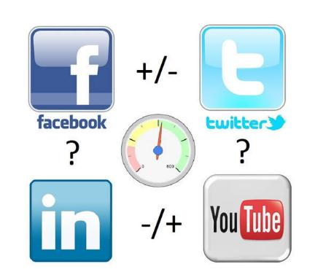
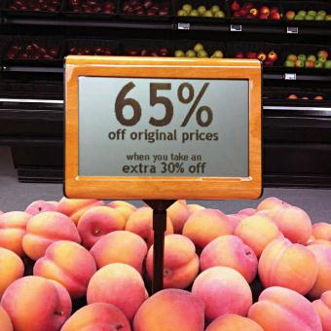
Automated content management
Freshness based mark-downs
Social sentiment analysis
Odormeter based real-time markdowns
Real-time data from Social media trend on products present in the store
Prevents Deli products wastage losses
Positively influences buying decision

Slide 8
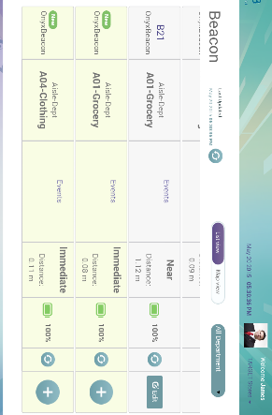
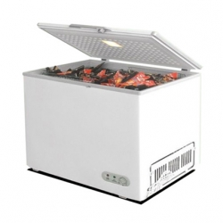
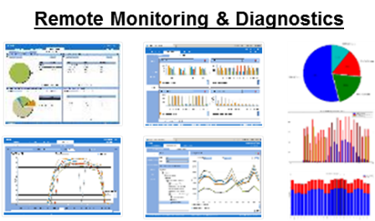
Energy and Devices management
Beacon Management
Energy Management
Freezer open detection
Real-time sensor information
Manage energy consumption across multiple stores
Nearest associate gets notified
Register all store beacons
Real-time data analytics
No manager interventions
Manages all sensors in store

Slide 9

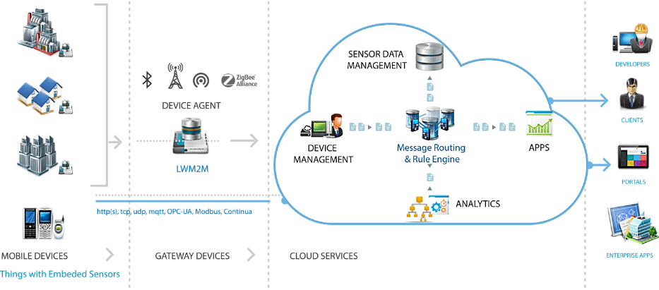

Empowering Stores - TCS Connected Universe Platform (TCUP)
TCS Provides a Scalable IOT Cloud Platform coupled with Deep Analytical and Mobile led Capabilities
TCS Connected Universe Platform (TCUP) is a Platform-as-a-Service (PaaS) offering that accelerates the development and deployment of IoT applications for Retail Organizations.
TCS named in Winner’s circle by analyst firm HfS’ research on HfS Blueprint 2015 IoT services
TCS won the 2014 M2M Evolution IoT Excellence Award for its TCUP IoT platform
Platform Capabilities
Device Management
Sensor Data Management
Message Routing
Task Services
Complex Event Processing
API Gateway

Slide 10
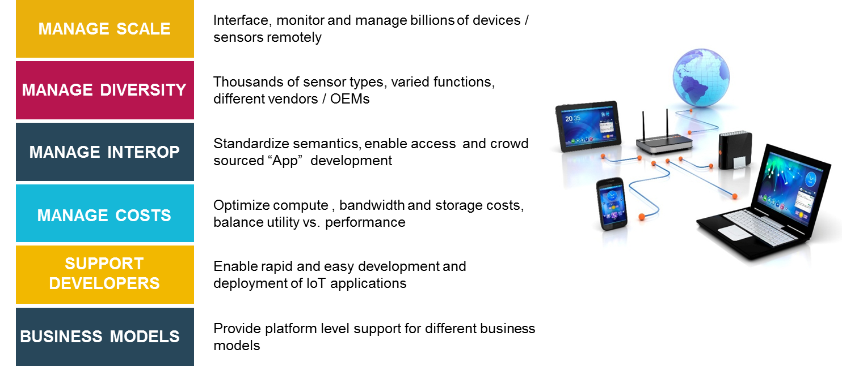
IoT Realization - Challenges addressed by TCUP
IoT Realizations : Challenges addressed by TCUP

Slide 11
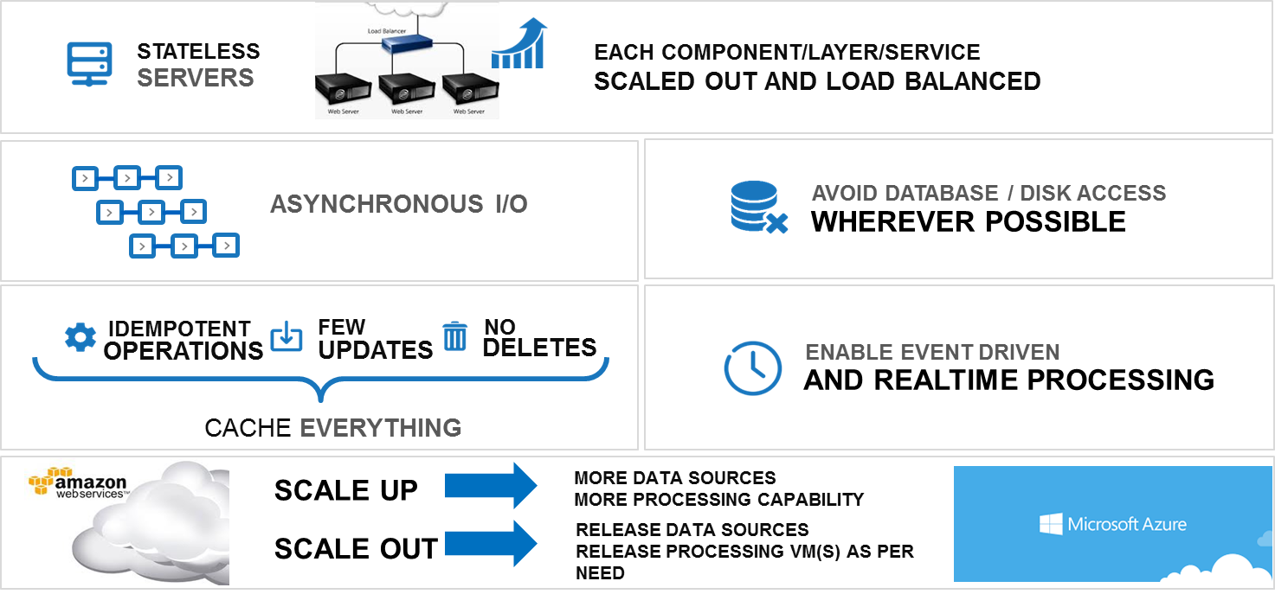
Scalability with TCUP
IoT Realizations : Challenges addressed by TCUP

Slide 12
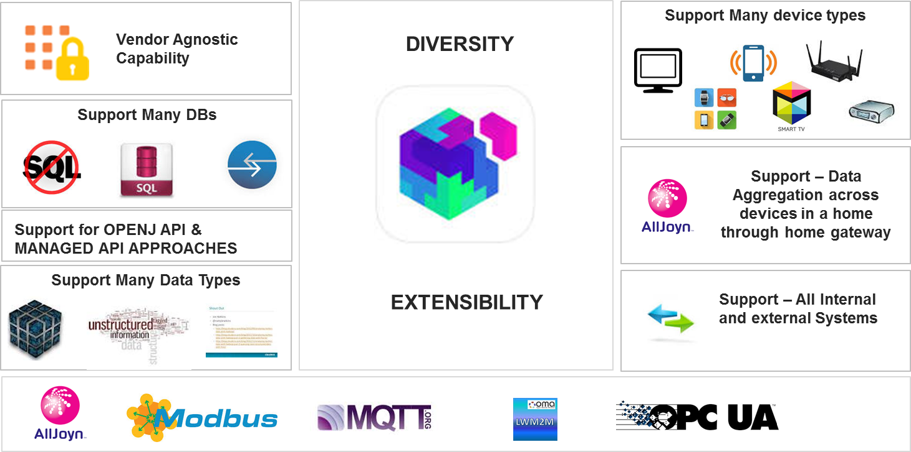
Diversity/Extensibility Support
IoT Realizations : Challenges addressed by TCUP

Slide 13
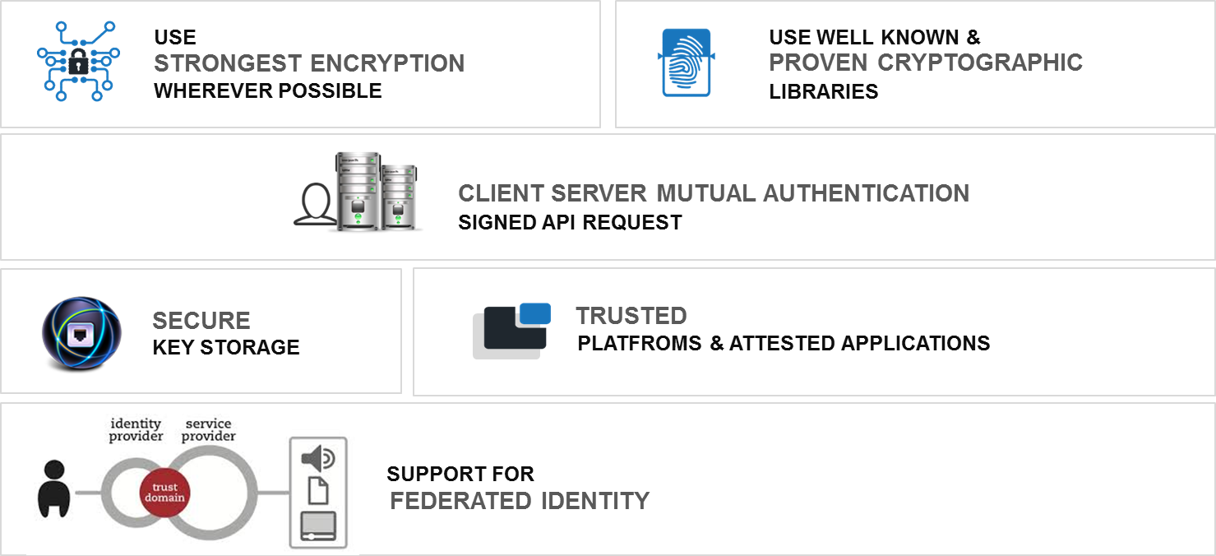
Security in TCUP

Slide 14


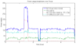



TCUP Case Study - Smart Campus Solution
Bus Tracking System
Location ( GPS), Speed, Accelerometer, Passenger Ids
CTO Cloud
TCUP + Apps
Sensor Interface Services
iDigi M2m Cloud
Device Management
Valid passenger lists, Route Info
Storage & Database Services
Reports & Alerts
Analytics Services
Parking Management
Images of cab registration number, Passenger Ids
Cab & Passenger Tracking
Images / video feeds of entry & exit ramps of underground parking lots

Slide 15
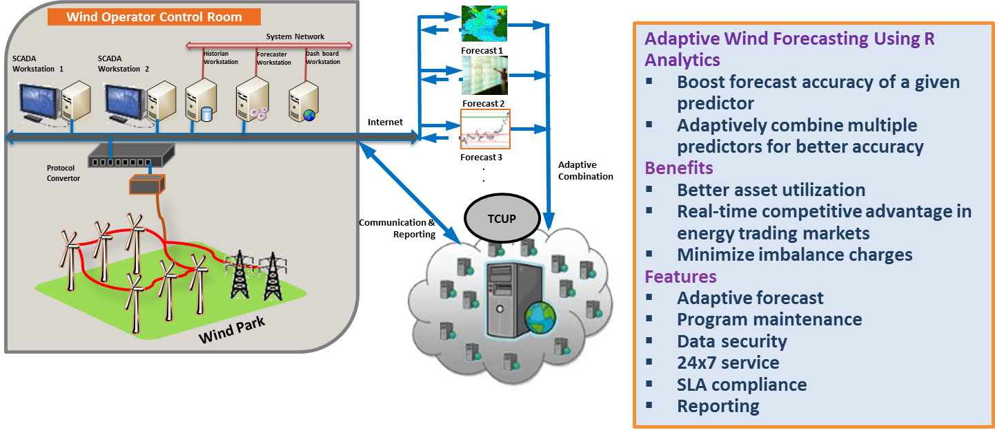
TCUP Case Study - Wind Forecasting Using R Analytics

Slide 16
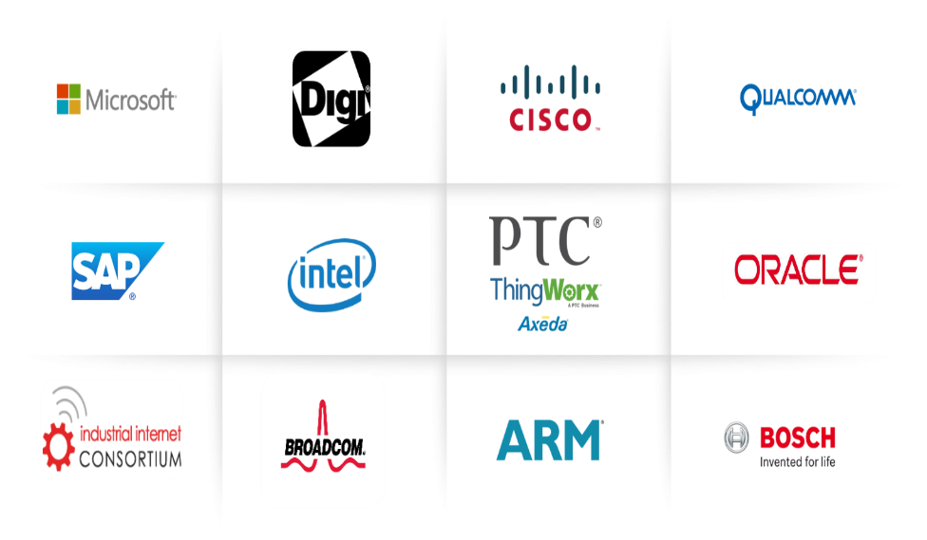
TCS IoT Alliances - Chip, Hardware, Software and Services

Slide 17
